Slide 1



Channabasaveshwara Institute of Technology (NAAC Accredited & ISO 9001:2015 Certified Institution) NH 206 (B.H. Road), Gubbi, Tumakuru – 572 216. Karnataka. (Affiliated to Visvesvaraya Technological University, Belagavi & Recognized by AICTE New Delhi) 2020-2021 DEPARTMENT OF COMPUTER SCIENCE & ENGINEERING INTRENSHIP PROJECT ON UBER PICKUPS IN NEWYORK CITY PREDICTION
Presented by:
Ashwini
1cg17cs010
Under the guidance of:
Mrs.Lalitha Bandeppa,M.Tech
Assistant professor
Dept. of CSE

Slide 2
CONTENTS
INTRODUCTION
PROBLEM STATEMENT
OBJECTIVES
EXISTING SYSTEM
PROPOSED METHODOLOGY
RESULTS
CONCLUSION

Slide 3
INTRODUCTION
The last two decades, the development of sensing and communication technology has brought the vehicles to a more connected and intelligent level.
The number of taxi pickups itself reflects the demand of the ride service.
Uber-like taxis are directed to the passengers and one request of ride service always correspond to a pickup.
To predict the number of pickups of Uber like taxis since a better understanding and forecasting of the travel demand helps to improve the efficiency and sustainability of the urban transportation system.
By using LSTM model

Slide 4
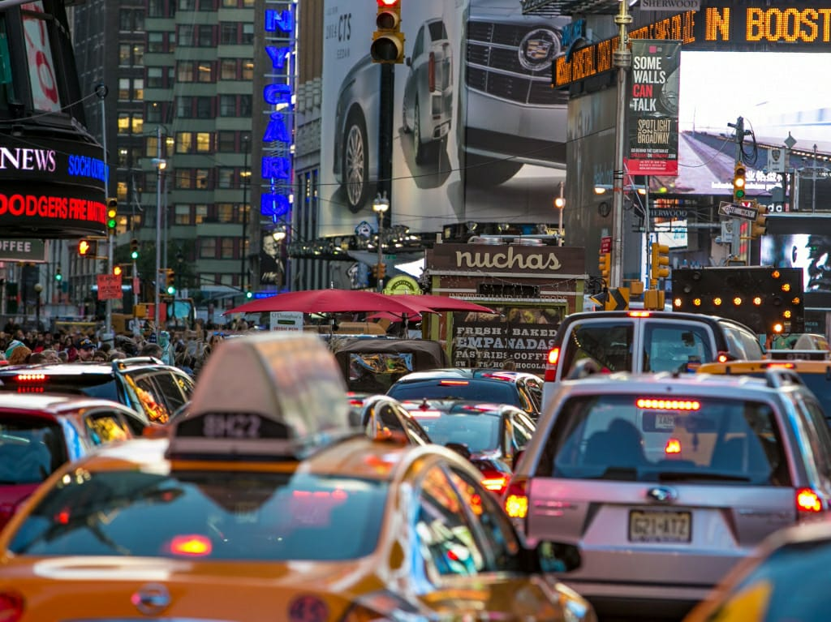
Continuing…
This directory contains data on over 4.5 million Uber pickups in New York City from April to September 2014, and 14.3 million more Uber pickups from January to June 2015. Trip-level data on 10 other for-hire vehicle (FHV) companies, as well as aggregated data for 329 FHV companies, is also included.

Slide 5
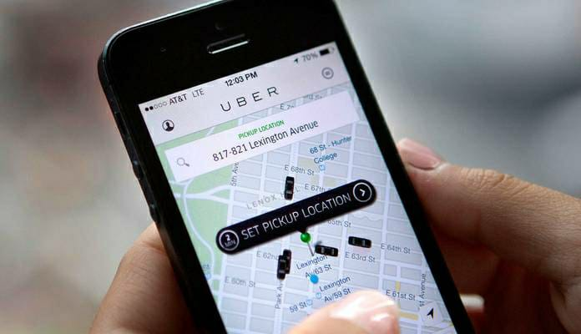
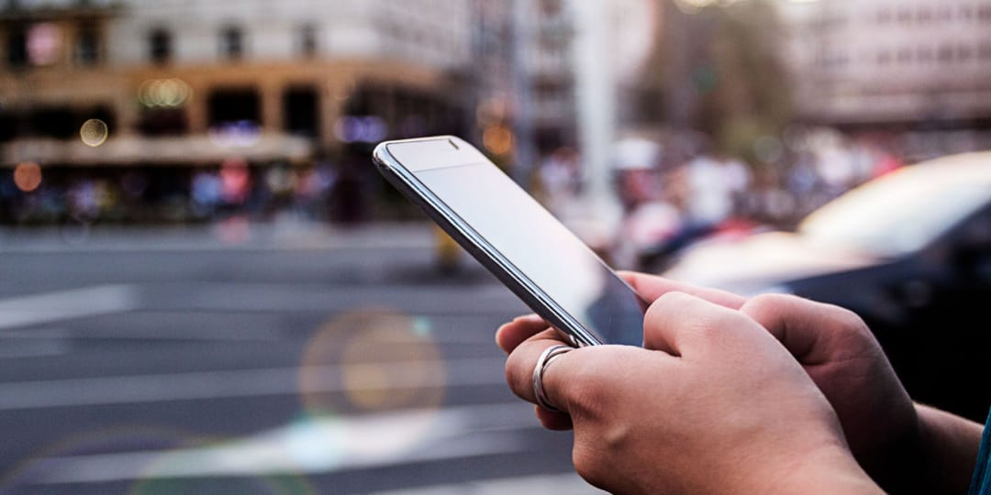
PROBLEM STATEMENT
Uber faces are laws in California that require ride-sharing companies to treat drivers as employees rather than independent contractors.
Changes in laws can also affect how much Uber pays in taxes.
It comes after a raft of recent studies have found negative effects from Uber and Lyft, such as increased congestion, higher traffic fatalities, huge declines in transit ridership and other negative impacts.

Slide 6
OBJECTIVES
Create the world’s biggest taxi in network, connecting riders with safe, reliable, convenient transportation providers at a variety of price points in cities around the world.
Create the world’s biggest p2p logistics platform, allowing anyone to either request or provide physical delivery of a myriad of goods & services.
Shift from 100% human-driven logistics to 100% machine-driven logistics

Slide 7
EXISTING SYSTEM
from an Uber driver is beautiful in its simplicity: simply open the app, set the pickup.
Back in 2011, during New Year's Even in New York, a journey of one mile went.
This new system has not yet been released, but Uber knows that in order to ... done needed to rework existing systems so that they fit an entirely new mold.

Slide 8
PROPOSED METHODOLOGY
proposed a hybrid method to predict the number of taxi pickups.
which contains over 4.5 million Uber pickups in New York City.
Visualize Uber's ridership growth in NYC during the period.
Characterize the demand based on identified patterns in the time series.
Estimate the value of the NYC market for Uber, and its revenue growth.
Other insights about the usage of the service.

Slide 9
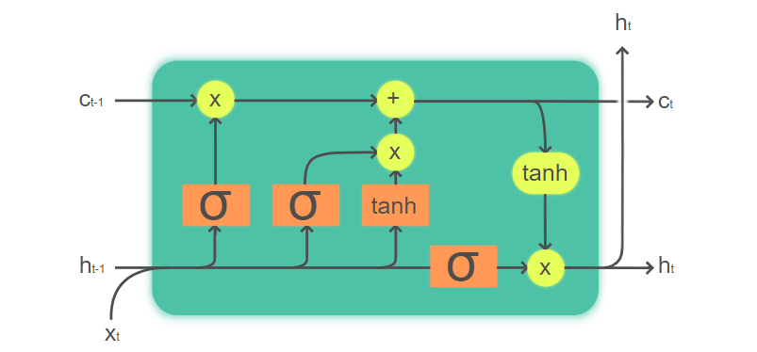
LSTM MODEL
Long Short-Term Memory (LSTM) networks are a type of recurrent neural network capable of learning order dependence in sequence prediction problems.
This is a behavior required in complex problem domains like machine translation, speech recognition, and more. LSTMs are a complex area of deep learning.

Slide 10
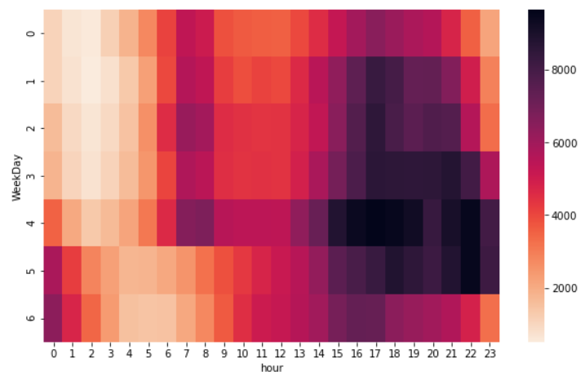
RESULTS
our proposed method outperforms the baseline ones and shows significant improvements. This means that the long-term dependencies captured by LSTM indeed have a positive influence on prediction
The demand for taxi and Uber are positively related to the length of roadways.
This is because Taxi and Uber’s demands are also related to the roadway density.
Demand have a significant impact in areas with longer mileage of roadway.

Slide 11
CONCLUSION
I have understood the deep learning based method to predict the number of Uber pickups.
A long short-term memory (LSTM) model is proposed aiming to capture the long-term dependencies of the pickup sequence over time.
For future work, it would be interesting to compare the Uber pickup data with New York taxi pickup data.
More advanced data mining techniques like tensor mining may help to discover deeper knowledge that may help to improve the Uber and/or taxi service system.

Slide 12
THANK YOU
.

